Slide 1


Slide 2

Text Classification On Hotel Review
Team Members
Bhabani B
Jiyashan P
Kavitha D K
Gaurav M
Atchuth kumar R
Rahul C
Shivraj S

Slide 3

CONTENT
Project Structure
Objective
Introduction to Text Classification
On Hotel Review
About Dataset
Data Preprocessing
EDA
Model Building
Model Selection
Deployment

Slide 4
Project Structure
Datasets
Import Libraries
Load Datasets
Data Preprocessing
Text Preprocessing: Tokenization, Lemmatization, Stopwords Removal, Punctuation Removal, Whitespace Removal
EDA
Class Distribution
Word Cloud
Sentiment Analysis
Model Building
Model Selection
Model Deployment

Slide 5
Objective
“The objective of this project is to develop an automated text classification model that can accurately classify hotel reviews as positive or negative.”

Slide 6
Introduction to Text Classification On Hotel Review
Defination:
Text classification, a fundamental task in natural language processing (NLP), involves assigning predefined categories or labels to text data. In the context of hotel reviews, text classification is used to automatically categorize reviews based on their sentiment—whether they are positiveor negative.
Purpose of Text classification :
The purpose of text classification is to automatically categorize or label text data into predefined classes or categories. This automation enables efficient analysis and understanding of large volumes of textual information.

Slide 7
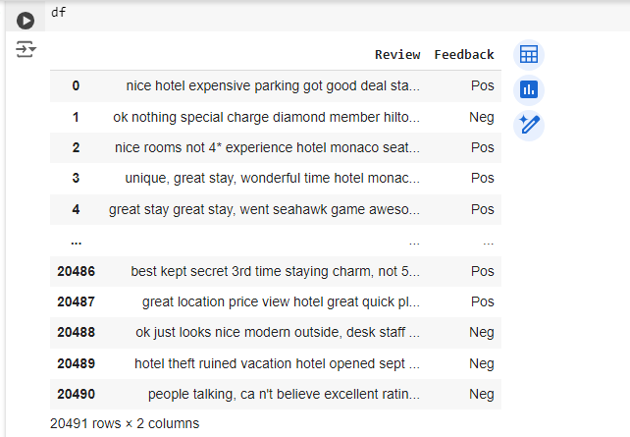
ABOUT DATASET
Description: the dataset likely contains the following types of data: Review text and feedback
Purpose: To train a text classification model that can predict the category of hotel reviews.
Dataset Using: Hotel Review.csv
No. of Rows: 20491
No.of Columns: 2

Slide 8
Data Pre-processing
Text Preprocessing
Tokenization: Splitting text into individual words or tokens.
Lemmatization: Reducing words to their base or root form.
Stopwords Removal: Removing common words that don't contribute to the sentiment.
Punctuation Removal: Eliminating punctuation to clean the text further.
Whitespace Removal: Removing unnecessary spaces.
Important modules/ packages installed for pre processing
import nltk
from nltk.corpus import stopwords
from nltk.stem import WordNetLemmatizer
from sklearn.feature_extraction.text import TfidfVectorizer
# Download necessary NLTK data
nltk.download('stopwords')
nltk.download('wordnet')

Slide 9
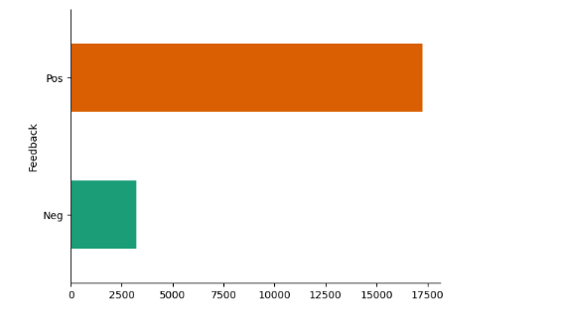
EDA
Class Distribution: Visualize the distribution of positive and negative reviews.
Word Cloud: Generate a word cloud to display the most frequent words in the reviews.
Sentiment Analysis: Perform a basic sentiment analysis to understand the polarity of reviews.

Slide 10
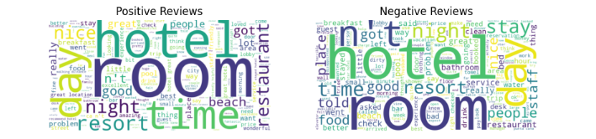
Word Cloud

Slide 11
Model Building
List of Models: Logistic Regression, Random Forest, SVM.
Vectorization: Transformed the text data using techniques like TF-IDF.
Model Training: trained each model, including hyperparameter tuning and validation techniques like cross-validation.
Model Evaluation:
Accuracy: Overall correctness of the model.
Precision: Correctness of positive predictions.
Recall: Ability to find all positive instances.
F1-Score: Balance between precision and recall.
Confusion Matrix:
Include confusion matrices for each model to show how well the model distinguishes between positive and negative reviews.

Slide 12
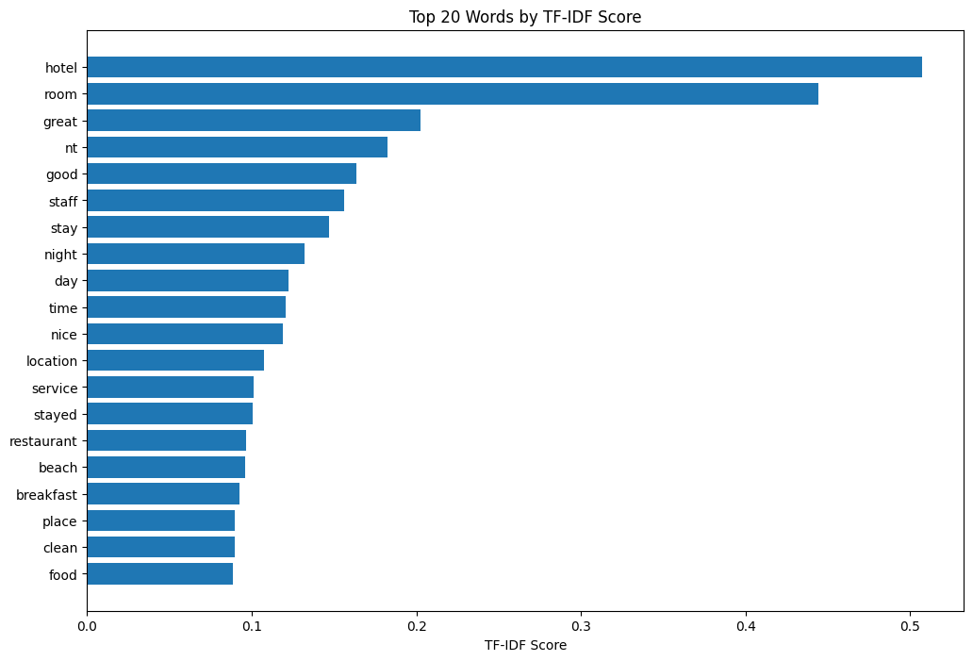
TF-IDF Vectorization

Slide 13
from sklearn.model_selection import train_test_split, GridSearchCV
from sklearn.naive_bayes import MultinomialNB
from sklearn.svm import SVC
from sklearn.ensemble import RandomForestClassifier
from sklearn.linear_model import LogisticRegression
from sklearn.metrics import accuracy_score, classification_report, f1_score
from imblearn.over_sampling import RandomOverSampler

Slide 14
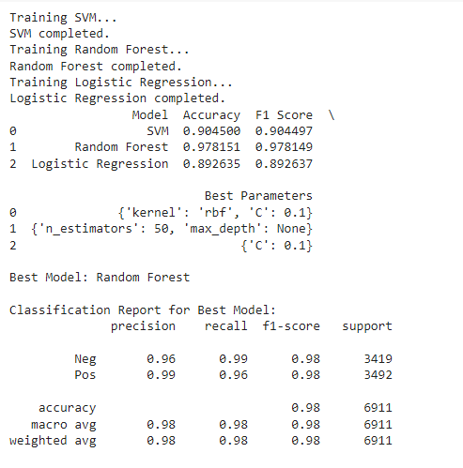
Model Selection
List of Models: Logistic Regression, Random Forest, SVM.

Slide 15
Deployment
Implementing the Text Classification Model using Streamlit
What is Streamlit: Streamlit is an open-source Python library that makes it easy to create and share custom web applications for machine learning and data science projects. It allows data scientists and machine learning practitioners to turn their data scripts into interactive web apps with minimal effort and without requiring extensive knowledge of web development.
Step-by-Step Deployment: Outline the steps taken to deploy the model using Streamlit.
Environment Setup: Setting up the Python environment with necessary libraries.
Streamlit Installation:Installing Streamlit using pip install streamlit
Developing the App: Writing the Streamlit app script to load the model, process inputs, and display predictions.
Running the App: Running the Streamlit app locally using streamlit run app.py

Slide 16
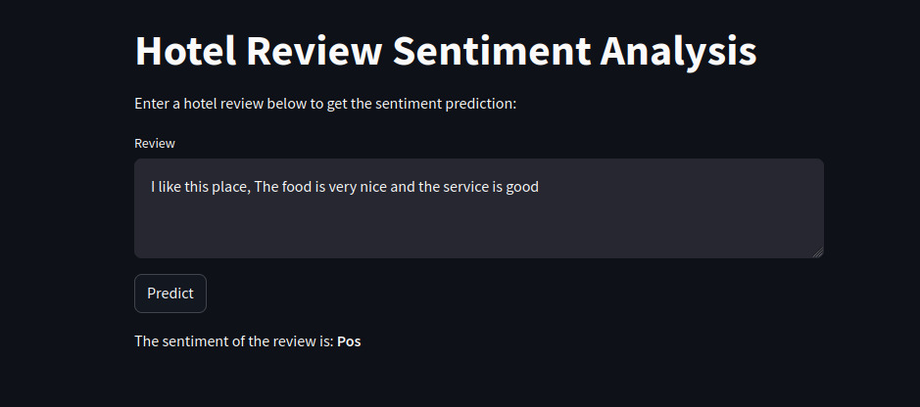
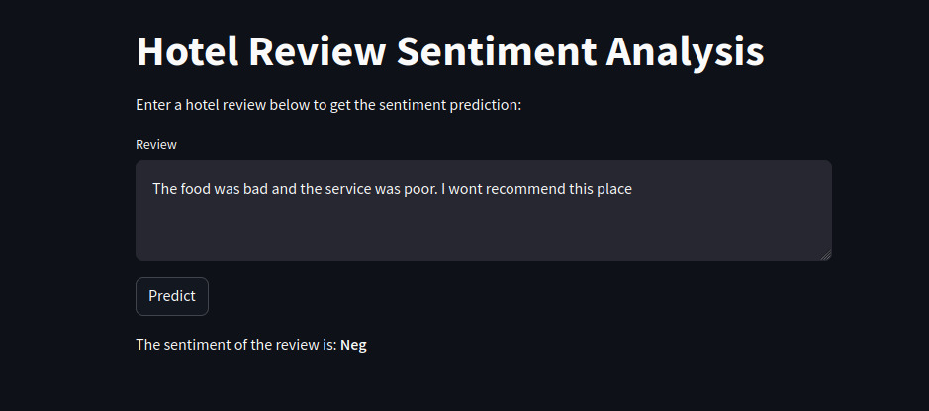
ScreenShot

Slide 17
Conclusion
We aimed to build a model to classify hotel reviews into positive or negative categories. We explored and evaluated three different models: Support Vector Machine (SVM), Random Forest, and Logistic Regression.
The Random Forest model, with its superior accuracy and performance metrics, is well-suited for this text classification task. It can be deployed in real-world applications to automatically classify hotel reviews, providing valuable insights for businesses to improve customer experience based on sentiment analysis.

Slide 18


